Slide 1

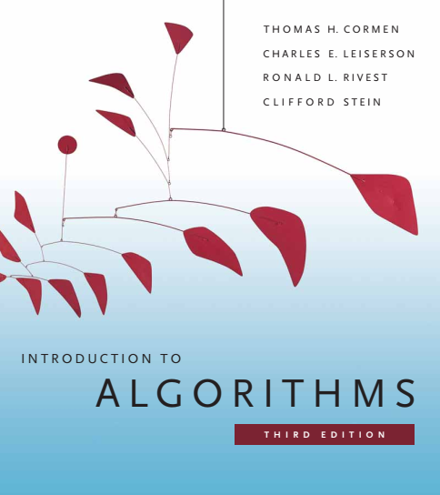
Design and Analysis of Algorithms
Dr. Sajid Iqbal
Reference Book
Introduction to Algorithms 3rd Edition By Thomas H. Cormen et. al.
https://mitpress.mit.edu/books/introduction-algorithms-third-edition
COMEDXD

Slide 2
Getting Started
Chapter 2

Slide 3
Background
An algorithm is a method to solve a computation problem
It can be written in different forms
Informal
Semi formal (pseudocode)
formal
def insertionSort(arr): for j in range(1, len(arr)): key = arr[j] i = j - 1 while i >= 0 and arr[i]<key: arr[i + 1] = arr[i] i = i - 1 arr[i + 1] = key arr = [12, 11, 13, 5, 6] insertionSort(arr) print("Sorted array is:") for i in range(len(arr)): print("%d" % arr[i])

Slide 4

RECAP
Analyzing an algorithm is predicting the resources that the algorithm requires.
Memory, communication bandwidth, computer hardware computational time
We analyze several alternate solutions and select the best one
Analysis of model (Cost Model)
We will use RAM model by assuming
A generic one processor,
random-access machine (RAM) model of computation
Sequential instructions execution
Although RAM model is good but should not be abused (realistic assumption should be made)
$X=a+b+c$ vs $X=a+b+c+d+e+f+g+h$
The RAM model should contains instructions commonly found in real computers:
arithmetic (such as add, subtract, multiply, divide, remainder, floor, ceiling),
Data movement (load, store, copy),
control (conditional and unconditional branch, subroutine call and return).
Each such instruction takes a constant amount of time.

Slide 5
RECAP
The RAM model
The data types in the RAM model are integer and floating point
All instructions of a program are in RAM
In the rest of this lecture, we will
Consider a problem
Analyze it using our RAM model

Slide 6
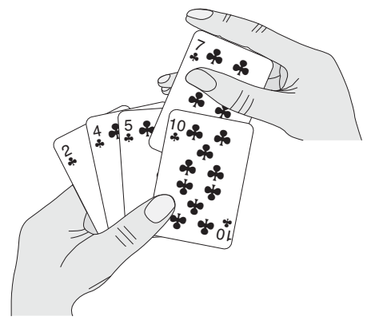

Insert Sort – a sorting problem
Input: A sequence of n numbers $<a_{1}, a_{2},…., a_{n}>.$
Output: A permutation (reordering) $<a_{1},′ a_{2}′,…., a_{n}′>.$of the input sequence such that $a_{1}’≤a_{2}’≤a_{3}’≤a_{4}’≤a_{5}’≤a_{6}’$
The numbers to be sorted are also known as the keys
Description of Insertion Sort
Insertion sort works the way many people sort a hand of playing cards.
We start with an empty left hand and the cards face down on the table.
We then remove one card at a time from the table and insert it into the correct position in the left hand.
To find the correct position for a card, we compare it with each of the cards already in the hand, from right to left
At all times, the cards held in the left hand are sorted, and these cards were originally the top cards of the pile on the table

Slide 7
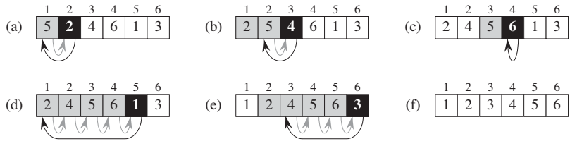
Insertion Sort
The algorithm sorts the input numbers in place: it rearranges the numbers within the array A, with at most a constant number of them stored outside the array at any time.
def insertionSort(arr): for j in range(1, len(arr)): key = arr[j] i = j - 1 while i >= 0 and arr[i]<key: arr[i + 1] = arr[i] i = i - 1 arr[i + 1] = key arr = [12, 11, 13, 5, 6] insertionSort(arr) print("Sorted array is:") for i in range(len(arr)): print("%d" % arr[i])

Slide 8
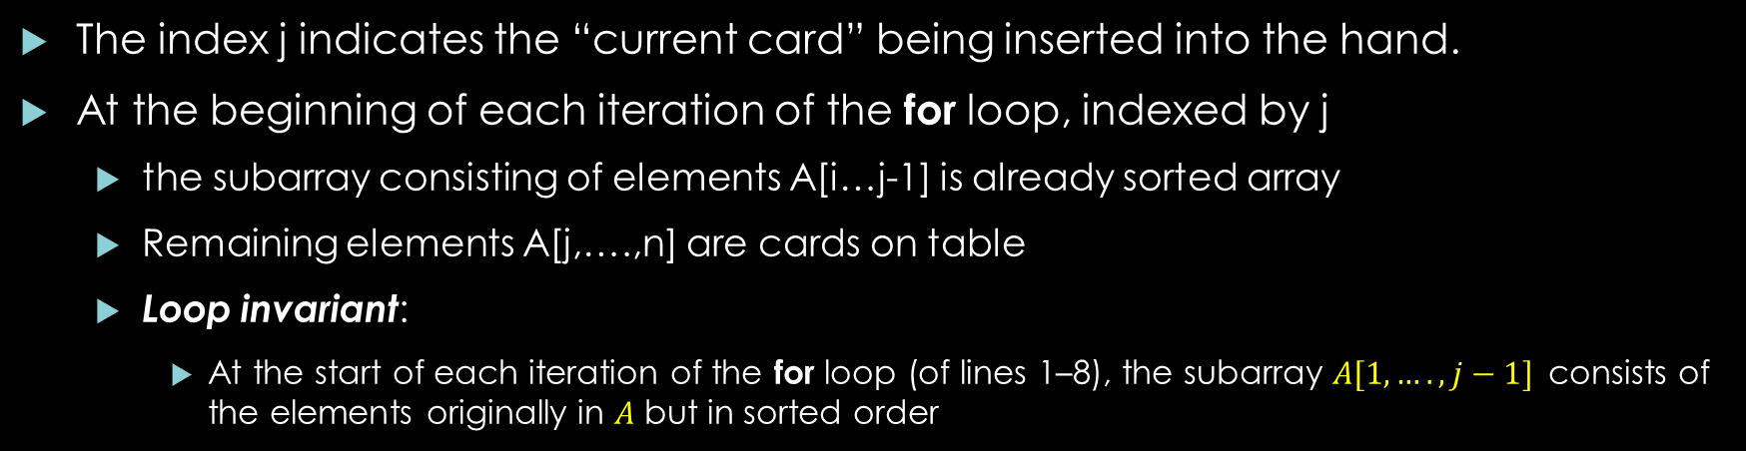
Loop invariants and the correctness of insertion sort
The index j indicates the “current card” being inserted into the hand.
At the beginning of each iteration of the for loop, indexed by j
the subarray consisting of elements A[i…j-1] is already sorted array
Remaining elements A[j,….,n] are cards on table
Loop invariant:
At the start of each iteration of the for loop (of lines 1–8), the subarray $A[1,….,j−1]$consists of the elements originally in $A$ but in sorted order
def insertionSort(arr): for j in range(1, len(arr)): key = arr[j] i = j - 1 while i >= 0 and arr[i]<key: arr[i + 1] = arr[i] i = i - 1 arr[i + 1] = key arr = [12, 11, 13, 5, 6] insertionSort(arr) print("Sorted array is:") for i in range(len(arr)): print("%d" % arr[i])
Loop invariant is used to help us understand why an algorithm is correct.

Slide 9
Mathematical induction
A technique for proving a statement to be true
This technique consists of three steps
Initial or base case: prove that statement is true for some base case i.e. 0 or 1
Inductive Hypothesis: Suppose that the statement hold (is true) for some case n
Induction Step: Prove that the case is also true for n+1 case
Do not worry, you may have read mathematical induction in previous classes

Slide 10

Mathematical Induction - Example
Let for natural numbers
Proposition: $P(n)=0+1+2+3+…..+n=\frac{n\left(n+1\right)}{2}$
Now we prove it with the help of induction
Base Case: $P(0)$can be easily seen to be true $0=\frac{0\left(0+1\right)}{2}→ 0=\frac{0}{2}→0=0$
Inductive Hypothesis: let $P(n)$ is true for some n. i.e. $1+2+…+n=\frac{n\left(n+1\right)}{2}$
Inductive Step: prove that the proposition is true for $n+1$
$1+2+3+…+n+(n+1)=\frac{\left(n+1\right)\left(n+1+1\right)}{2}$
now we work on LHS to prove it equal to RHS
$\frac{n\left(n+1\right)}{2}+(n+1)$ $→\frac{n\left(n+1\right)+2\left(n+1\right)}{2} →\frac{\left(n+1\right)\left(n+2\right)}{2} →\frac{\left(n+1\right)\left(n+1+1\right)}{2}$ → RHS
https://en.wikipedia.org/wiki/Mathematical_induction

Slide 11
Properties of Loop Invariant(LI)
Initialization: It is true prior to the first iteration of the loop.
Maintenance: If it is true before an iteration of the loop, it remains true before the next iteration.
Termination: When the loop terminates LI show that the algorithm is correct.
You can see that loop invariant is similar to mathematical induction which proves the correctness of algorithm
def insertionSort(arr): for j in range(1, len(arr)): key = arr[j] i = j - 1 while i >= 0 and arr[i]<key: arr[i + 1] = arr[i] i = i - 1 arr[i + 1] = key arr = [2,5,4,6,1,3] insertionSort(arr) print("Sorted array is:") for i in range(len(arr)): print("%d" % arr[i])
[2, 5, 4, 6, 1, 3]
[2, 4, 5, 6, 1, 3]
[2, 4, 5, 6, 1, 3]
[1, 2, 4, 5, 6, 3]
[1, 2, 3, 4, 5, 6]

Slide 12
Analyzing Insertion Sort
The time taken by the INSERTION-SORT procedure depends on the input size
Different permutations of same input size may take different time
Generally, the as the size of input grows, the running time of algorithm grows
So we define the terms “running time” and “size of input” more carefully.
Input size may be count of numbers to sorted, number of input bits, single or multiple inputs
The running time of an algorithm on a particular input is the number of primitive operations or “steps” executed.
Notion of step is usually defined platform independent.
We, as already discussed, assume that one instruction will take constant time i.e. C
[0, 1, 2, 3, 4, 5, 6]
[1, 2, 3, 4, 6, 0, 5]
[2, 4, 5, 6, 1, 3, 0]
[6, 5, 4, 3, 2, 1, 0]

Slide 13
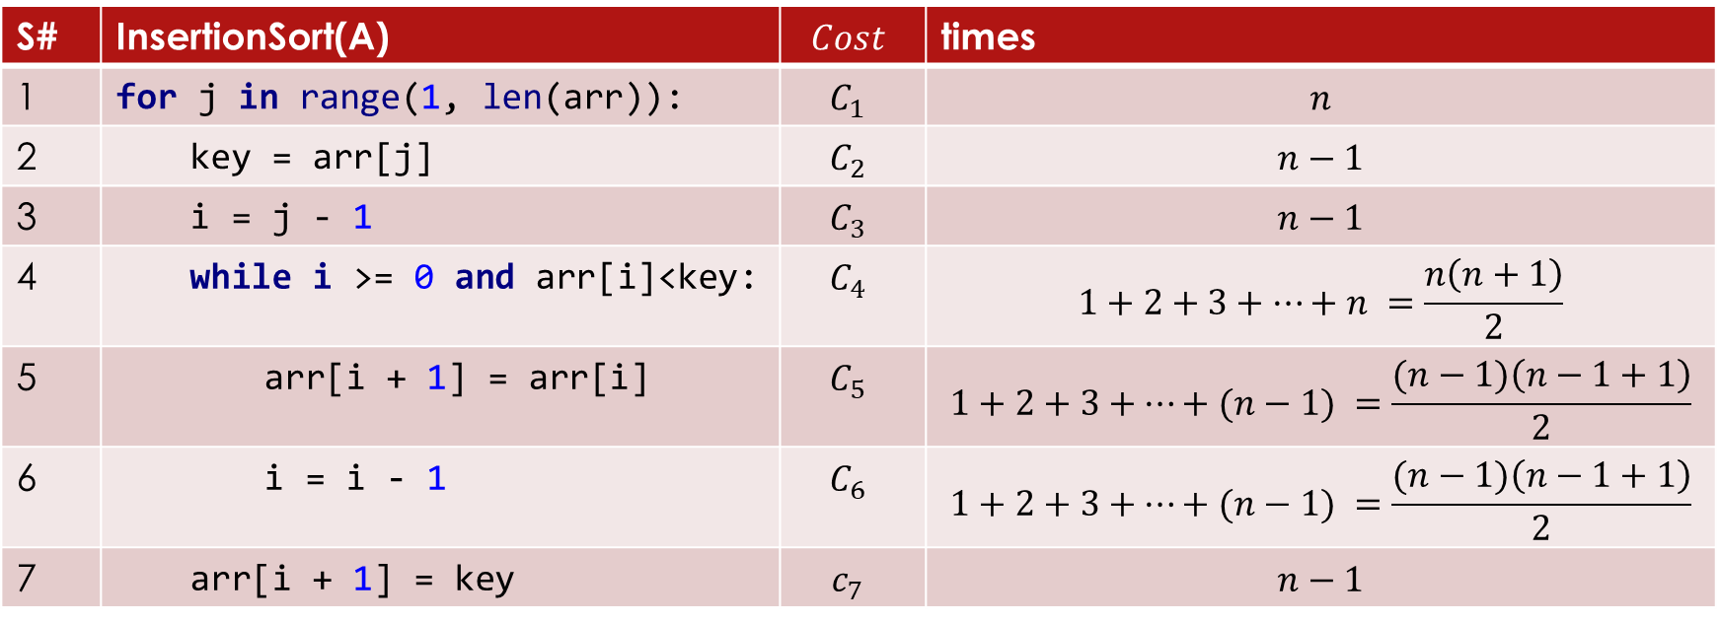
Time complexity of Insertion Sort
S# | InsertionSort(A) | $$Cost$$ | times
1 | for j in range(1, len(arr)): | $$C_{1}$$ | $$n$$
2 | key = arr[j] | $$C_{2}$$ | $$n−1$$
3 | i = j - 1 | $$C_{3}$$ | $$n−1$$
4 | while i >= 0 and arr[i]<key: | $$C_{4}$$ | $$1+2+3+…+n =\frac{n\left(n+1\right)}{2}$$
5 | arr[i + 1] = arr[i] | $$C_{5}$$ | $$1+2+3+…+(n−1) =\frac{(n−1)\left(n−1+1\right)}{2}$$
6 | i = i - 1 | $$C_{6}$$ | $$1+2+3+…+(n−1) =\frac{(n−1)\left(n−1+1\right)}{2}$$
7 | arr[i + 1] = key | $$c_{7}$$ | $$n−1$$
$$F\left(n\right)=c_{1}n+c_{2}\left(n−1\right)+c_{3}\left(n−1\right)+c_{4}\left(\frac{n\left(n+1\right)}{2}\right)+c_{5}\left(\frac{\left(n−1\right)\left(n−1+1\right)}{2}\right)+c_{6}\left(\frac{\left(n−1\right)\left(n−1+1\right)}{2}\right)+c_{7}(n−1)$$

Slide 14

Insertion Sort - Time Complexity
$F\left(n\right)=c_{1}n+c_{2}\left(n−1\right)+c_{3}\left(n−1\right)+c_{4}\left(\frac{n\left(n+1\right)}{2}\right)+c_{5}\left(\frac{\left(n−1\right)\left(n−1+1\right)}{2}\right)+c_{6}\left(\frac{\left(n−1\right)\left(n−1+1\right)}{2}\right)+c_{7}\left(n−1\right)$
$F\left(n\right)=c_{1}n+c_{2}n−c_{2}+c_{3}n−c_{3}+\frac{c_{4}n^{2}}{2}+\frac{c_{4}n}{2}+\frac{c_{5}n^{2}}{2}−\frac{c_{5}n}{2}+\frac{c_{6}n^{2}}{2}−\frac{c_{6}n}{2}+\left(n−1\right)$
$F\left(n\right)={\frac{c_{4}n^{2}}{2}+\frac{c_{5}n^{2}}{2}+\frac{c_{6}n^{2}}{2}+c}_{1}n+c_{2}n+c_{3}n+\frac{c_{4}n}{2}−\frac{c_{5}n}{2}−\frac{c_{6}n}{2}+n−c_{2}−c_{3}−c_{7}$
$F\left(n\right)=\left({\frac{c_{4}n^{2}}{2}+\frac{c_{5}n^{2}}{2}+\frac{c_{6}n^{2}}{2})+(c}_{1}n+c_{2}n+c_{3}n+\frac{c_{4}n}{2}−\frac{c_{5}n}{2}−\frac{c_{6}n}{2}+n\right)−{(c}_{2}+c_{3}+c_{7})$
$F\left(n\right)=\left({\frac{c_{4}}{2}+\frac{c_{5}}{2}+\frac{c_{6}}{2})n^{2}+(c}_{1}+c_{2}+c_{3}+\frac{c_{4}}{2}−\frac{c_{5}}{2}−\frac{c_{6}}{2}+c_{7}\right)n+{(−c}_{2}−c_{3}−c_{7})$
$F\left(n\right)=an^{2}+bn+c$
worst-case running time

Slide 15
Thanks for watching
Dr. Sajid Iqbal
Assistant Professor
Department of Computer Science
Bahauddin Zakariya University, Multan
Allah Hafiz

